Slide 1
STAT 6838 Statistical research II
Thanh Doan

Slide 2
Overview about the problem
Netflix is a movie rental business
To help their customers find movies, they developed a movie recommendation system: CinematchSM
Its job is to predict whether someone will enjoy a movie based on how much they liked or disliked other movies.

Slide 3
Overview about the problem
Netflix uses those predictions to make personal movie recommendations based on each customer’s unique tastes.
To see whether alternative approaches can beat CinematchSM by making better predictions, Netflix make a contest.

Slide 4
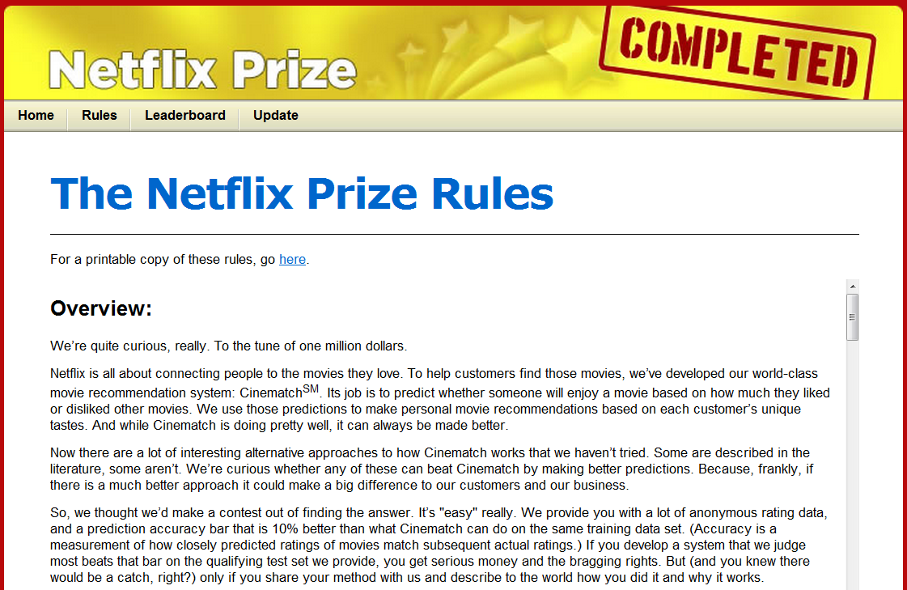
Netflix Prize

Slide 5
Netflix Prize
Netflix provide movie rating data and a prediction accuracy bar that is 10% better than what Cinematch can do on the same training data set
Accuracy is a measurement of how closely predicted ratings of movies match subsequent actual ratings.
If someone develop a system that beats that bar on the qualifying test set, they get $1M Grand Prize
Only if they non-exclusively license the solution to Netflix and describe to the world how they did it and why it works

Slide 6
Netflix datasets
Include a training set and qualifying test sets
Training data consist of 100,480,507 ratings from 480,189 users on 17,770 movies
Each training rating is of the form:
<user, movie, date of rating, rating>
For each movie, title and year of release are provided in a separate dataset

Slide 7
Netflix datasets
The qualifying data set contains 2,817,131 triplets of the form
<user, movie, date of rating>
With ratings known only to the jury.

Slide 8
Netflix datasets
A participating algorithm must predict ratings on the entire qualifying set, but they are only informed of the score for half of the data, the quiz set of 1,408,342 ratings.
The other half is the test set of 1,408,789, and performance on this is used by the jury to determine potential prize winners.
This arrangement is intended to make it difficult to hill climb on the test set

Slide 9
Measuring prediction accuracy
Submitted predictions are scored against the true ratings in terms of root mean squared error (RMSE), and the goal is to reduce this error as much as possible
The RMSE measure is the square root of the averaged squared difference between each prediction and the actual rating in each subset, rounded to the nearest .0001

Slide 10
CinematchSM prediction accuracy bar
CinematchSM scores an RMSE of 0.9514 on the quiz data. It has a similar performance on the test set, 0.9525
In order to win the grand prize a participating algorithm had to improve this by 10%
To achieve 0.8572 on the test set
Such an improvement on the quiz set corresponds to an RMSE of 0.8563

Slide 11
My research objectives (1)
Learn statistical methods in building recommendation systems
Read chapter 9 of the book http://infolab.stanford.edu/~ullman/mmds/ch9.pdf
Read papers published by the wining teams of the Netﬂix Grand Prize
Write software to implement algorithms published by winners of the Netﬂix Prize
Build scalable recommendation system that run on Map-reduced parallel systems (on top of Hadoop)

Slide 12
My research objectives (2)
Give it a shot. Try to improve the prediction accuracy further
Measuring the confidence of the predictions
Measuring the coverage of predictions
i.e. find which titles a system can make a good prediction
Apply different (or own) methods/algorithms
Incorporate new input features into the training set (such as other data about the movies, like genres, actors, directors, countries, etc)

Slide 13
References
http://www.netflixprize.com/
http://www2.research.att.com/~volinsky/netflix/bpc.html
http://en.wikipedia.org/wiki/Netflix_Prize

